Slide 1
Discrete Math
Lab 1 - September, 8

Slide 2
Agenda
Course Introduction
TA introduction, office hours
Grading policy
Textbook
Main Part
Introduction to proofs
Proof by contradiction
Proof by induction

Slide 3
TA introduction
Maria Naumcheva
PhD Student at Innopolis University
Office: 413
E-mail: m.naumcheva@innopolis.university
Telegram: @MaryNaumcheva
Office hours: by appointment
Research interest:
Requirements engineering

Slide 4
TA introduction
Khomyakov Ilya
PhD Student at Innopolis University
Office: nope
E-mail: i.khomyakov@innopolis.university
Telegram: @X0mak
Office hours: by appointment
Research interest:
Software metrics

Slide 5
TA introduction
Ruzilia Mukhutdinova
PhD Student at Innopolis University
E-mail: r.mirgalimova@innopolis.ru
Office hours will be in Zoom: by appointment
Research interest:
Project Management
Requirements engineering Cyber Physical Systems

Slide 6
Grading
Course points:
Labs – 20 points (see below)
3 in-class tests – 10 points each
Mid-term – 25 points
Final exam – 25 points
Labs points:
In-class participation 0.5 point for each individual contribution in a class but not more than 0.5 points a week (i.e. 7 points in total for 14 study weeks),
Home assignments 1 point for each homework (i.e. 13 points in total).
Attendance is mandatory, we will check it at every lab

Slide 7
Textbook
Kenneth H. Rosen "Discrete Mathematics and Its Applications, 7th Edition“

Slide 8
Introduction to proofs
Proof is a valid argument that establishes the truth of a mathematical statement.
Argument is a sequence of statements that end with a conclusion.
By valid, we mean that the conclusion, or final statement of the argument, must follow from the truth of the preceding statements, or premises, of the argument.
Statements that can be shown to be true are called propositions or theorems.

Slide 9
Basic proof techniques
Direct proof
Proof by construction
Proof by contradiction
Proof by induction

Slide 10
Direct proof
Way of showing the truth or falsehood of a given statement by a straightforward combination of established facts, usually axioms, existing lemmas and theorems, without making any further assumptions
The example of direct proof was shown in the tutorial

Slide 11

Proof by construction
A method of proof that demonstrates the existence of a mathematical object by creating or providing a method for creating the object
Example Prove that there exist nonzero integers x, y, z such that $x^{2}+y^{2}=z^{2}$.
Notes:
Take x = 3, y = 4, z = 5. For these numbers the statement is true, so we showed that such nonzero integers exist.

Slide 12
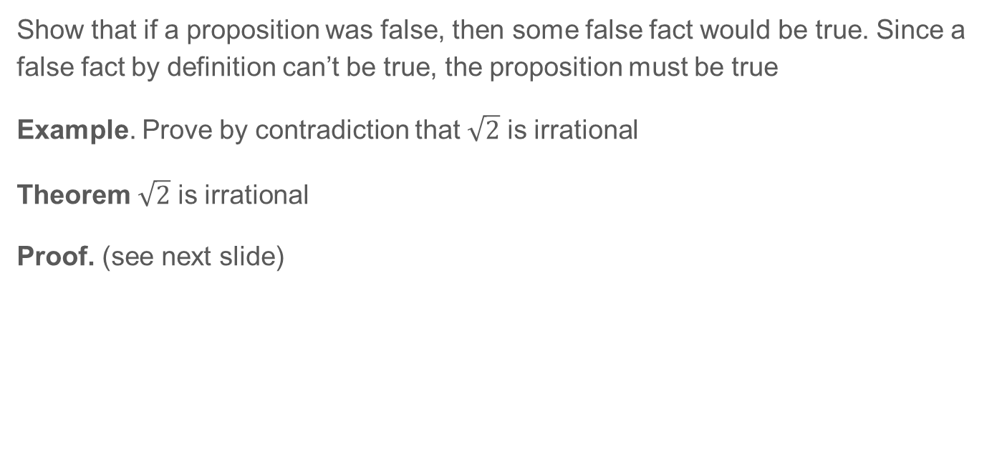
Proof by contradiction
Show that if a proposition was false, then some false fact would be true. Since a false fact by definition can’t be true, the proposition must be true
Example. Prove by contradiction that $\sqrt{2}$ is irrational
Theorem $\sqrt{2}$ is irrational
Proof. (see next slide)

Slide 13
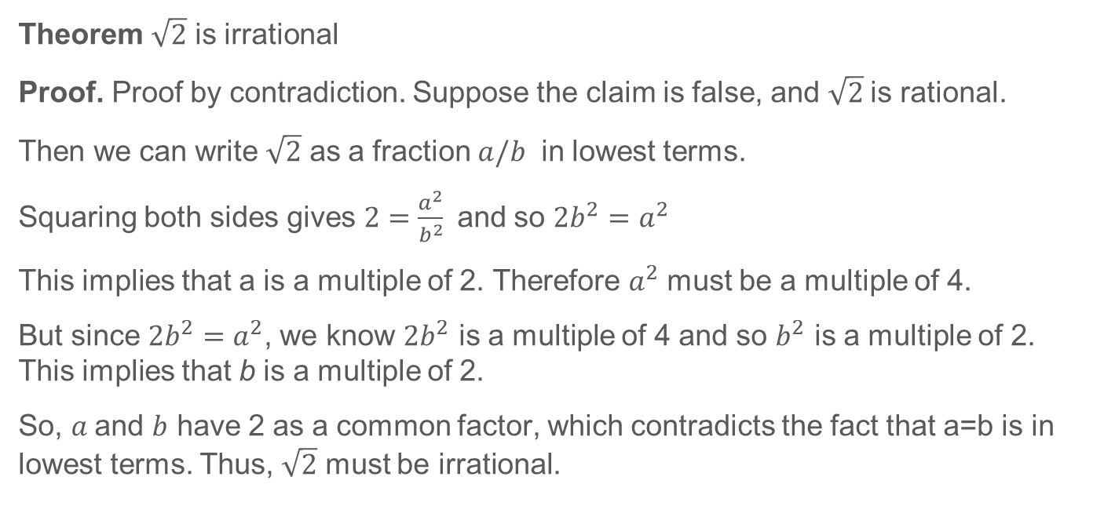
Proof by contradiction example
Theorem $\sqrt{2}$ is irrational
Proof. Proof by contradiction. Suppose the claim is false, and $\sqrt{2}$is rational.
Then we can write $\sqrt{2}$ as a fraction $a/b$ in lowest terms.
Squaring both sides gives $2=\frac{a^{2}}{b^{2}}$and so $2b^{2}=a^{2}$
This implies that a is a multiple of 2. Therefore $a^{2}$ must be a multiple of 4.
But since $2b^{2}=a^{2}$, we know $2b^{2}$ is a multiple of 4 and so $b^{2}$ is a multiple of 2. This implies that b is a multiple of 2.
So, $a$and $b$ have 2 as a common factor, which contradicts the fact that a=b is in lowest terms. Thus, $\sqrt{2}$ must be irrational.

Slide 14
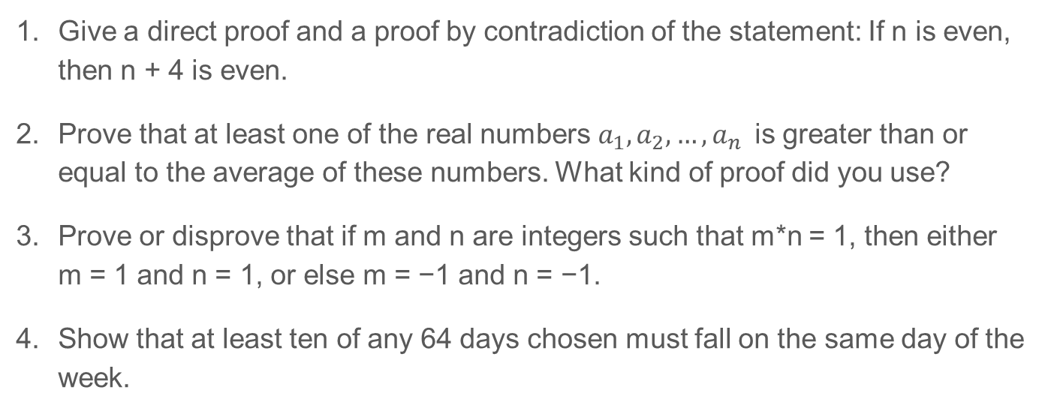
Exercises
Give a direct proof and a proof by contradiction of the statement: If n is even, then n + 4 is even.
Prove that at least one of the real numbers $a_{1}, a_{2},…, a_{n}$is greater than or equal to the average of these numbers. What kind of proof did you use?
Prove or disprove that if m and n are integers such that m*n = 1, then either m = 1 and n = 1, or else m = −1 and n = −1.
Show that at least ten of any 64 days chosen must fall on the same day of the week.
Notes:
1. For a direct proof, the hypothesis implies that n = 2k for some k, whence n + 4 = 2(k + 2), so n + 4 is even.
For a proof by contradiction, assume that n = 2k and n + 4 = 2l+1 for some k and l. Subtracting gives 4 = 2(l - k) + 1, which means that 4 is odd, a contradiction.
2. Suppose instead that all of the numbers a1, a2, ... , an are less than their average, which we can denote by A.
In symbols, we have ai < A for all i.
If we add these n inequalities, we see that a1 + a2 + ·· · + an < nA . By definition, A = (a1 + a2 + · ·· + an)/n The two displayed formulae clearly contradict each other, however: they imply that nA < nA. Thus our assumption must have been incorrect, and we conclude that at least one of the numbers a, is greater than or equal to their average.
3. This proposition is true. We give a proof by contradiction. Suppose that m is neither 1 nor -1. Then mn has a factor (namely lml) larger than 1. On the other hand, mn = 1, and 1 clearly has no such factor. Therefore we conclude that m = 1 or m = -1. It is then immediate that n = 1 in the first case and n = -1 in the second case, since mn = 1 implies that n = 1/m
4. We give a proof by contradiction. If there were nine or fewer days on each day of the week, this would account for at most 9 · 7 = 63 days. But we chose 64 days. This contradiction shows that at least ten of the days must be on the same day of the week.

Slide 15
Proof by induction
Propositional function P(n) is a statement containing one or more variables that becomes a proposition when each of its variables is assigned a value or is bound by a quantifier
PRINCIPLE OF MATHEMATICAL INDUCTION To prove that P(n) is true for all positive integers, where P(n) is a propositional function, we complete two steps: BASIS STEP: We verify that P(1) is true. INDUCTIVE STEP: We show that the conditional statement P(k) → P(k + 1) is true for all positive integers k.
The assumption that P(k) is true is called the inductive hypothesis

Slide 16
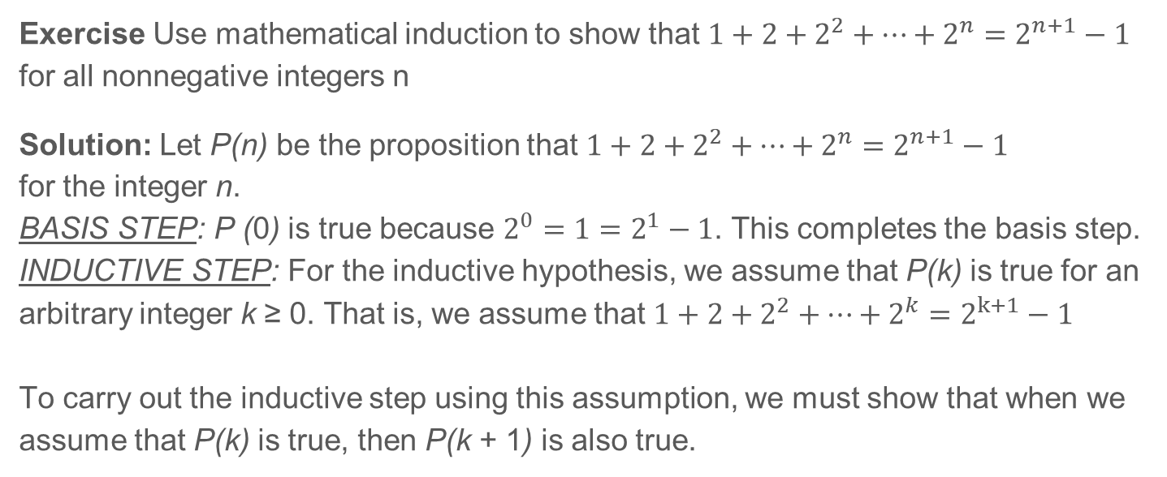
Proof by induction - Example
Exercise Use mathematical induction to show that $1+2+2^{2}+…+2^{n}=2^{n+1}−1$ for all nonnegative integers n
Solution: Let P(n) be the proposition that $1+2+2^{2}+…+2^{n}=2^{n+1}−1$ for the integer n. BASIS STEP: P (0) is true because $2^{0}=1=2^{1}−1$. This completes the basis step. INDUCTIVE STEP: For the inductive hypothesis, we assume that P(k) is true for an arbitrary integer k ≥ 0. That is, we assume that $1+2+2^{2}+…+2^{k}=2^{k+1}−1$ To carry out the inductive step using this assumption, we must show that when we assume that P(k) is true, then P(k + 1) is also true.

Slide 17
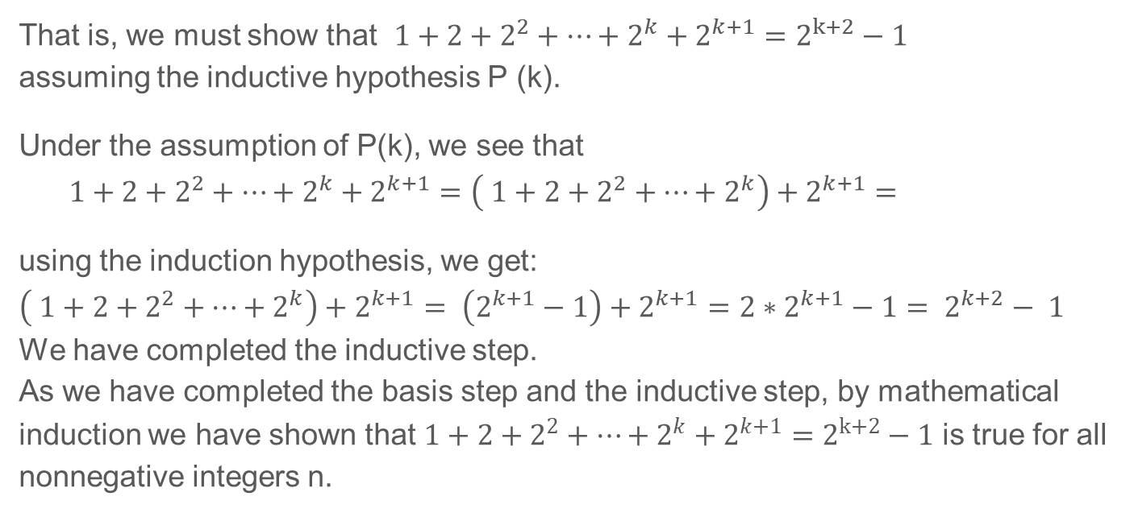
Proof by induction – Example (continued)
That is, we must show that $1+2+2^{2}+…+2^{k}+2^{k+1}=2^{k+2}−1$ assuming the inductive hypothesis P (k).
Under the assumption of P(k), we see that $$1+2+2^{2}+…+2^{k}+2^{k+1}=\left( 1+2+2^{2}+…+2^{k}\right)+2^{k+1}=$$
using the induction hypothesis, we get:
$\left( 1+2+2^{2}+…+2^{k}\right)+2^{k+1}= \left(2^{k+1}−1\right)+2^{k+1}=2∗2^{k+1}−1= 2^{k+2}− 1$
We have completed the inductive step. As we have completed the basis step and the inductive step, by mathematical induction we have shown that $1+2+2^{2}+…+2^{k}+2^{k+1}=2^{k+2}−1$ is true for all nonnegative integers n.

Slide 18
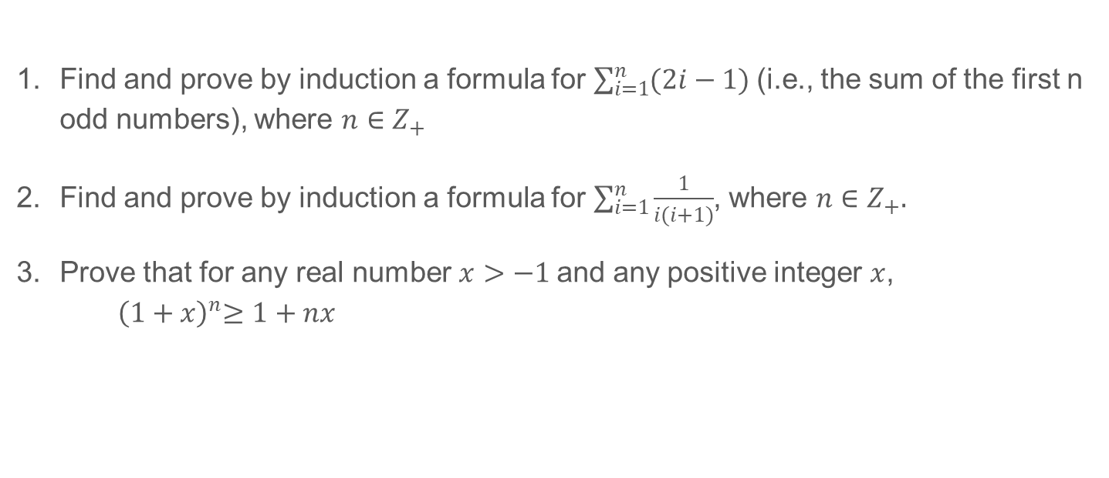
Exercises II
Find and prove by induction a formula for $\sum_{i=1}^{n}{(2i−1) }$(i.e., the sum of the first n odd numbers), where $n∈Z_{+}$
Find and prove by induction a formula for $\sum_{i=1}^{n}{\frac{1}{i(i+1)}}$, where $n∈Z_{+}.$
Prove that for any real number $x>−1$and any positive integer $x$, ${ \left(1+x\right)}^{n}≥1+nx$
Notes:
See “induction sampler” pages 2-3

Slide 19
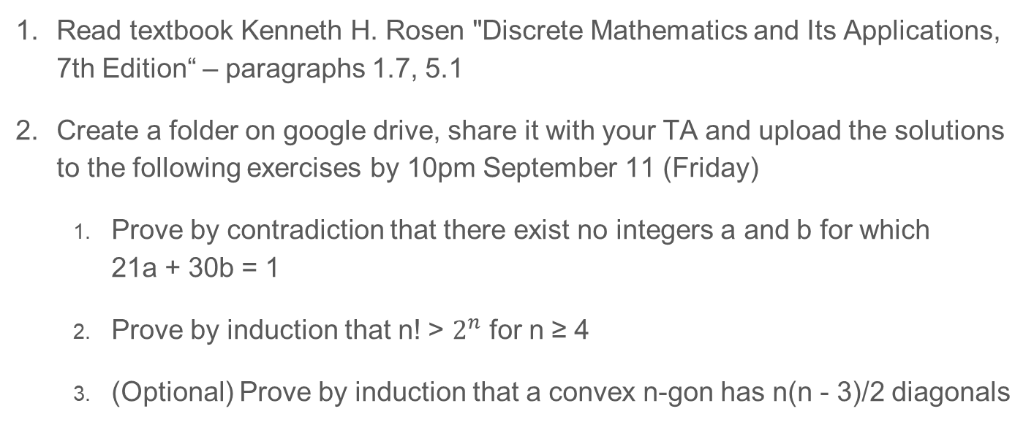
Homework
Read textbook Kenneth H. Rosen "Discrete Mathematics and Its Applications, 7th Edition“ – paragraphs 1.7, 5.1
Create a folder on google drive, share it with your TA and upload the solutions to the following exercises by 10pm September 11 (Friday)
Prove by contradiction that there exist no integers a and b for which 21a + 30b = 1
Prove by induction that n! > $2^{n}$ for n ≥ 4
(Optional) Prove by induction that a convex n-gon has n(n - 3)/2 diagonals

